Slide 1
Instrument Detection
Scientific Programming in Python (PHYS4038 UNUK)
Divyansh Oze

Slide 2
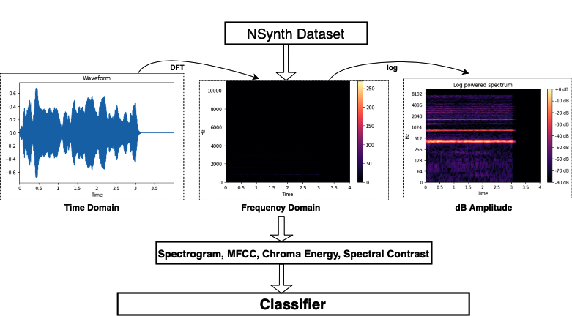
Objectives
Detect instruments playing in the background of an audio clip
To pick a Music Dataset.
To study the Anatomy of a .wav file
To build up our own efficient features for the prediction task.
Find out what classifiers to use to detect/predict the instruments.
Fig. [1] Figure explaining the objectives with what we have used
1
[1]. McFee, Brian, Colin Raffel, Dawen Liang, Daniel PW Ellis, Matt McVicar, Eric Battenberg, and Oriol Nieto. “librosa: Audio and music signal analysis in python.” In Proceedings of the 14th python in science conference, pp. 18-25. 2015.

Slide 3
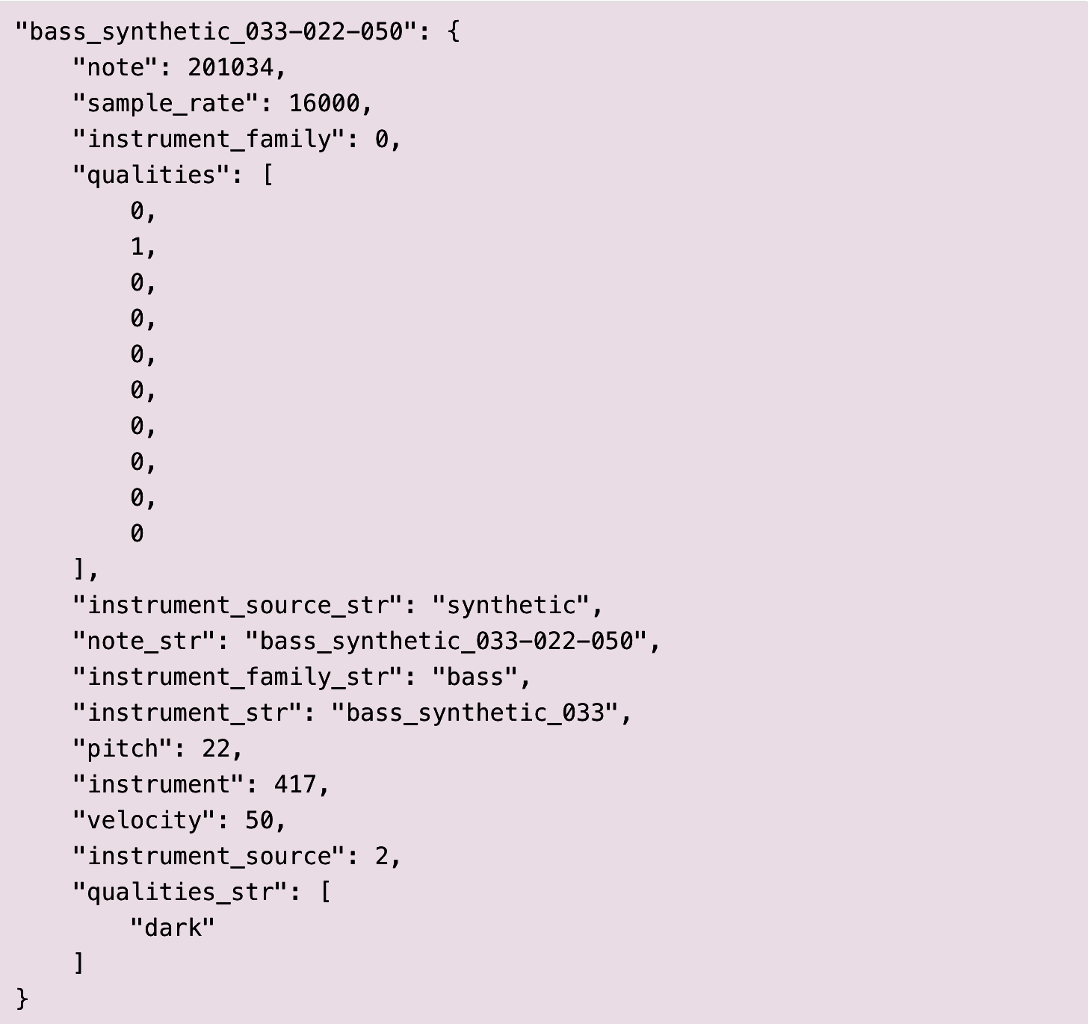
Features from the NSynth
NSynth Dataset:
Huge audio dataset containing musical notes. Each with unique pitch, timbre and envelope.
The features are in a JSON file format.
It includes the four second, .wav audio files.
Target Label
Fig. [2] View of format in JSON files
[2] . https://magenta.tensorflow.org/datasets/nsynth

Slide 4
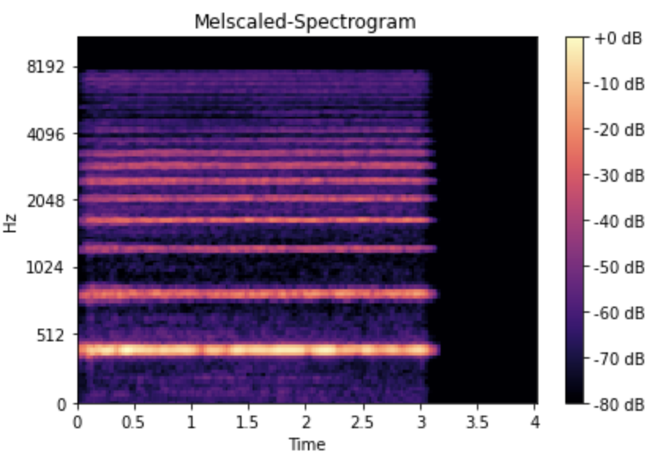
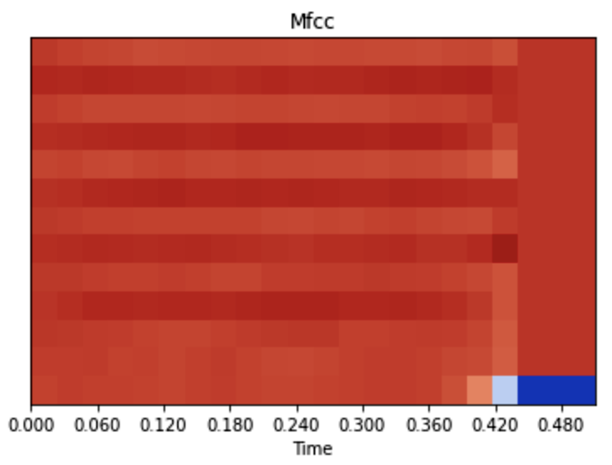
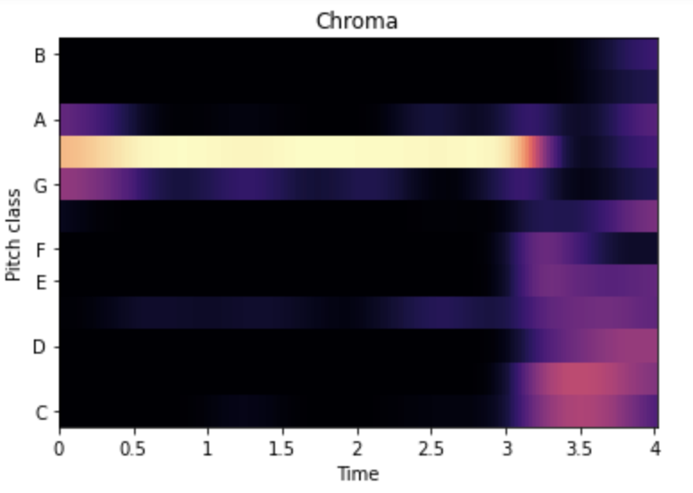
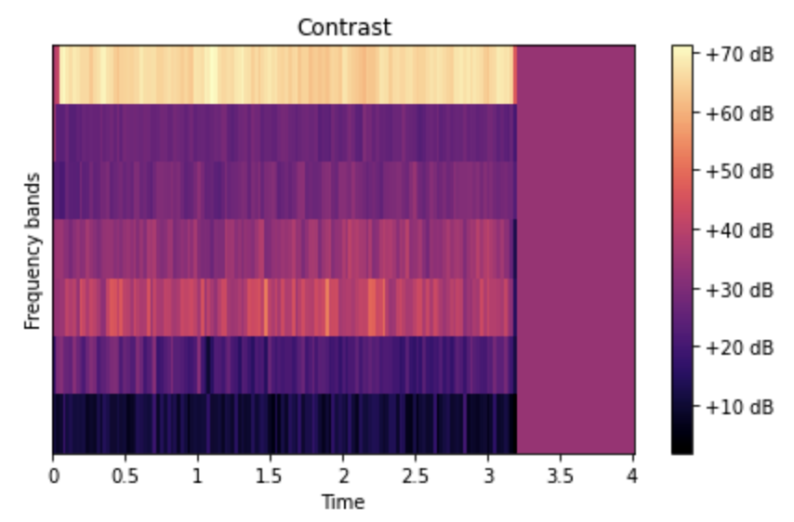
Generated Features Using AudioClips
Example performed on a VocalAcoustic .wav file
Mel spectrogram: “loudness” of a signal
MFCC: helps in overall recognition
CENS: chord recognition or harmonic similarity
Contrast: spectral peaks, valleys and difference between freq. sub-bands
Figure. [4] Visual Representation of a Mel Spectrogram
Figure. [5] Visual Representation of a MFCC
Figure. [6] Visual Representation of CENS
Figure. [7] Visual Representation of Spectral Contrast

Slide 5
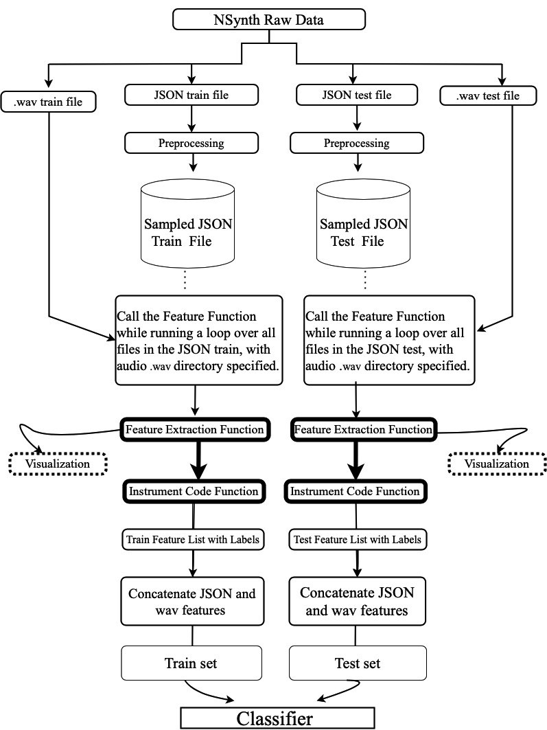
Flow Diagram
Feature Extraction:
The function returns all of the extracted features from the audio .wav files
Visualization can be done through the same function while outputting the features
Instrument Code:
Function that takes in a file and returns label i.e. instrument based on naming convention
Fig.[8] Flow Diagram for the Project

Slide 6
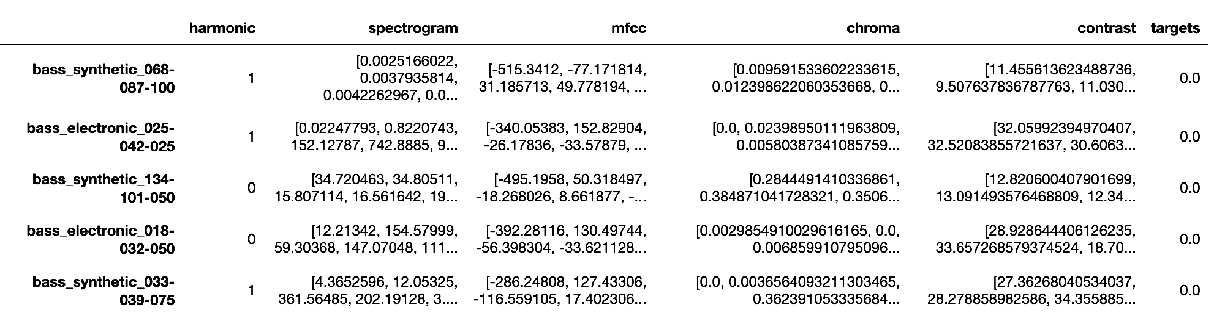
Results
We extracted our own features from the .wav audio files using librosa for audio processing, bumpy and pandas for handling data.
Visual Representations on the added features using Matplotlib and Librosa.
Figure. [9] A DataFrame showing the Feature List with target labels
Reference
Feature List with Targets/Labels for Train and Test sets.
Targets determining the Instrument Family here.
Instrument Families are code specified [0-10] for each instrument class.

Slide 7
Potential Improvements
Get Visual Representations corresponding to all the examples in a particular class label.
Add more features that could help in the overall prediction, e.g Spectral rolloff
Introducing a Neural Network like CNN for Classification.
Feed the visual represented graphs to a CNN in form of images.
Run the Instrument Detection Model on songs to determine the major instrument playing in the background.

